Slide 1


Gamifying AI Interactions: The Game Play Pattern
This presentation explores a powerful and innovative design pattern for AI interactions, known as the Game Play Pattern. This pattern leverages game mechanics like scenarios, challenges, and rewards to create engaging, interactive, and memorable experiences for users. We'll examine its core concepts, benefits, and real-world applications, and provide examples to illustrate its potential in various fields.
by Kaviprakash Ramalingam
Notes:
Presenter: [Your Name]

Slide 2
Defining the Game Play Pattern
Definition and Core Concepts
Purpose and Benefits
The Game Play Pattern introduces game-like elements into AI interactions to create engaging and interactive experiences. It's built on:
This pattern is particularly valuable in Natural Language Processing (NLP) because it:
Enhances engagement and retention, making interactions more enjoyable and memorable.
Immersive Scenarios: Engaging backstories and settings that draw users into the game world.
Encourages learning through interaction, allowing users to grasp concepts actively rather than passively consuming information.
Interactive Challenges: Tasks like puzzles, quizzes, or decision-based adventures that users actively participate in.
Reward Systems: Providing positive feedback, points, badges, or other rewards for user actions and achievements.

Slide 3

Applications of the Game Play Pattern
Educational Games
Interactive Storytelling
Customer Onboarding
Interactive learning platforms like Duolingo utilize the Game Play Pattern to make language learning fun and effective. Users engage in games, earn points, and progress through levels, promoting sustained engagement.
The Game Play Pattern can enhance interactive storytelling apps, allowing users to shape the narrative by making choices and interacting with the characters. This provides personalized and immersive experiences.
Chatbots that employ the Game Play Pattern can guide new customers through complex processes in an engaging and entertaining way. This improves user satisfaction and reduces support requests.

Slide 4
The Quest for the Crystal of Wisdom: A Case Study
Prompt 2: Riddle
Scenario Description
Prompt 2: "You've chosen the left path. A riddle appears: 'I speak without a mouth and hear without ears. I have no body, but I come alive with wind. What am I?' Solve the riddle or choose another path." This prompt introduces a challenge that tests user knowledge or creativity.
Imagine an AI-powered treasure hunt within a virtual town called Wordsville. Players embark on a quest to find the lost Crystal of Wisdom, hidden somewhere within the town. The game unfolds through prompts, challenges, and choices made by the players.
1
2
3
Prompt 1: Choice
Prompt 1: "You find yourself in a dark forest. Ahead, there are three paths: one leads to the crystal, one to a dead end, and one to danger. Choose a path (A: Left, B: Middle, C: Right)." This sets the stage, offering users an active decision that guides the game's direction.

Slide 5



AI Responses and Game Dynamics
Response to Prompt 1
Response to Prompt 2
The AI, trained on the game's narrative, provides a descriptive response based on the user's choice. If the user chooses the left path, the AI might describe a winding path leading through a forest with rustling leaves and the sound of birdsong.
The AI evaluates the user's response to the riddle. If the user correctly identifies the answer (an echo), the AI rewards them with a clue about the crystal's location. If they fail, they might encounter a minor setback or be presented with an alternative path.

Slide 6
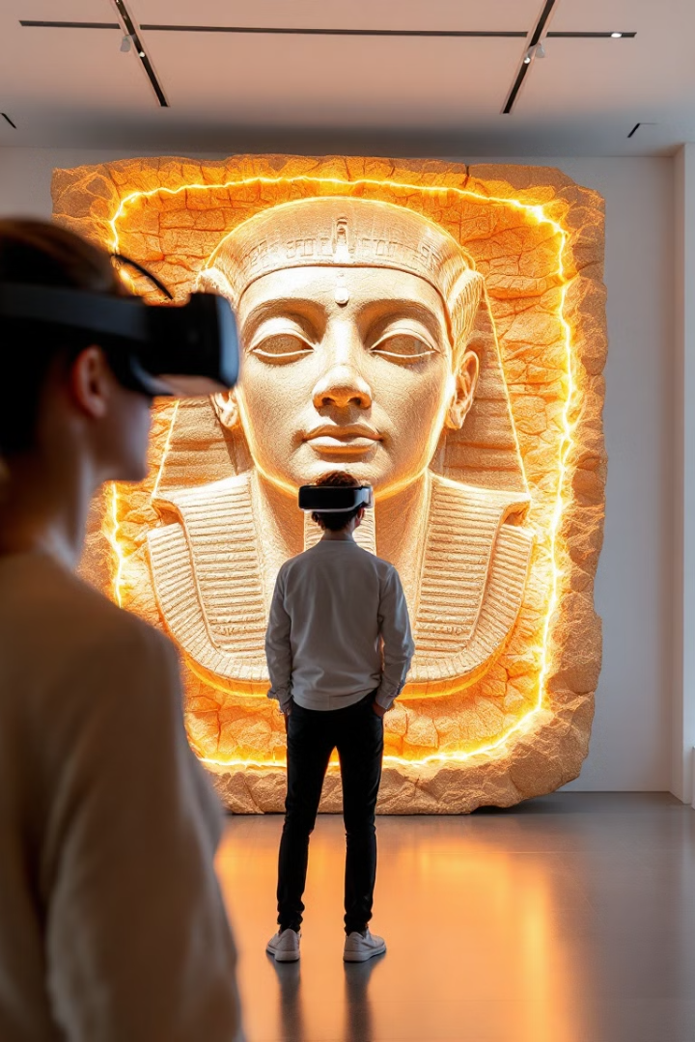



The Power of Gamification in AI Applications
Enhanced Learning
Increased Engagement
The Game Play Pattern transforms passive information consumption into active learning. Users actively participate in the game, solving puzzles, making choices, and receiving feedback, leading to deeper understanding and retention.
The game-like elements create a sense of fun and excitement, captivating users and motivating them to explore the content. This extends the duration of their interaction and increases the overall enjoyment of the experience.
Memorable Experiences
By combining learning with entertainment, the Game Play Pattern makes information more memorable. Users associate the content with positive emotions and are more likely to recall it later, enhancing the overall effectiveness of the AI interaction.

Slide 7

Real-World Examples and Future Directions
1
2
Museum Tours
Product Onboarding
The Game Play Pattern can be applied to create engaging and interactive museum tours. Visitors can embark on virtual quests to discover artifacts, solve historical riddles, and learn about exhibits in a fun and immersive way.
AI-powered onboarding experiences for new products or services can incorporate the Game Play Pattern to guide users through the process, providing interactive tutorials, quizzes, and rewards for completing tasks.
3
Personalized Learning
The Game Play Pattern can personalize educational experiences by adapting to individual learning styles and pace. AI can provide customized challenges, feedback, and rewards based on user progress.

Slide 8
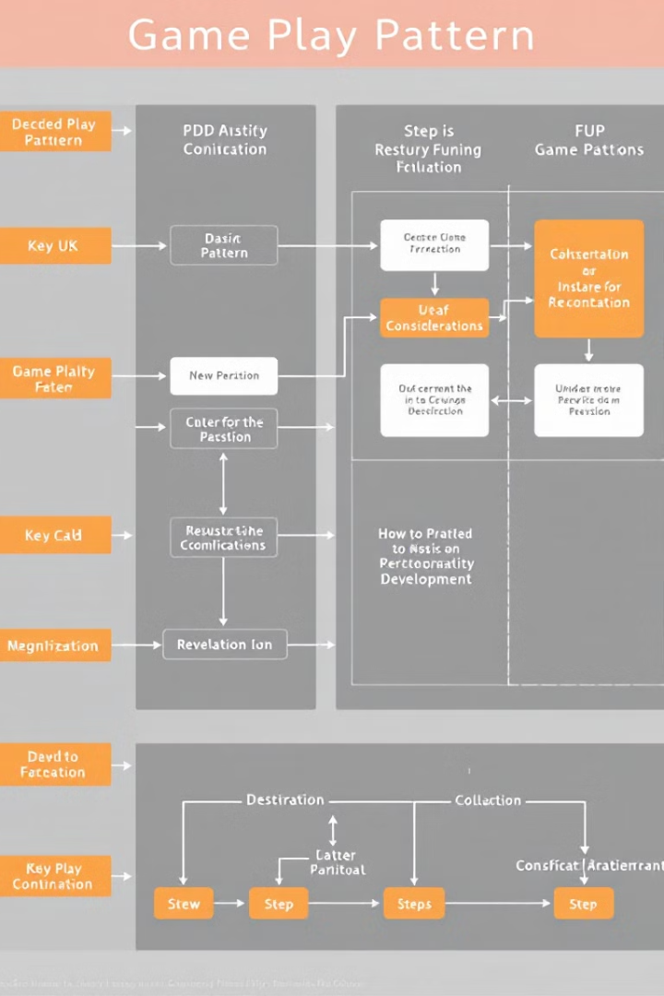
Next Steps and Conclusion
The Game Play Pattern offers exciting opportunities to transform AI interactions into engaging and impactful experiences. By incorporating game mechanics, AI developers can create applications that are both informative and entertaining, fostering learning, engagement, and lasting memories for users.

